Slide 1

Informer: Beyond Efficient Transformer for Long Sequence Time-Series Forecasting
Lee Jieun(222DBG04)
Bigdata Analytics
model
conclusion
solution
problem

Slide 2
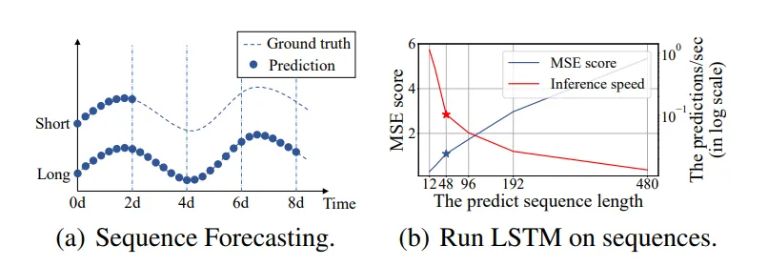
problem when using long sequences
< (a)Short sequence time series forecasting, long sequence time series forecasting (b) run LSTM on sequences.
>
Notes:
(a)Short sequence time series forecasting, long sequence time series forecasting

Slide 3
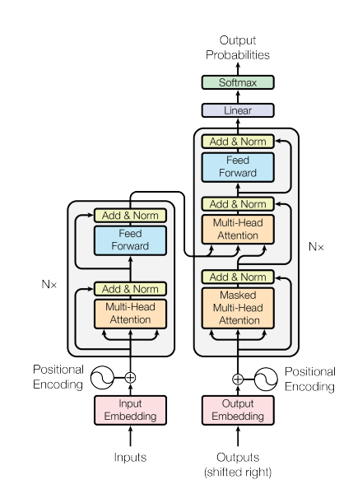
The Transformer Architecture

Slide 4
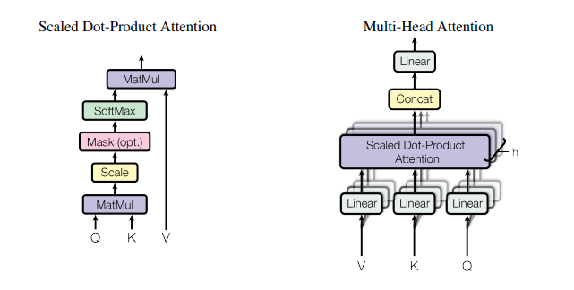
Attention Architecture
< (Left) Scaled Dot-Product Attention. (right) Multi-Head Attention consists of several attention layers running in parallel >

Slide 5

Time series forecasting using transformer
Vanilla Transformer (Vaswani et al. 2017) 의 한계점
1. The quadratic computation of self-attention. The atom operation of self-attention mechanism, namely canonical dot-product, causes the time complexity and memory usage per layer to be O($L^{2}$ ).
2. The memory bottleneck in stacking layers for long inputs. The stack of J encoder/decoder layers makes total memory usage to be O(J · $L^{2}$ ), which limits the model scalability in receiving long sequence inputs.
3. The speed plunge in predicting long outputs. Dynamic decoding of vanilla Transformer makes the step-by-step inference as slow as RNN-based model.
Notes:
선행연구에서는 연산의 효율성(한계점 1번)에 대해서만 해결책을 제시 • 현실적인 LSTF 문제의 관점에서 한계점 2번과 한계점 3번에 대한 해결책을 제시하고 있지 않음 본 연구에서는 모든 1,2,3 번 한계점에 대한 해결책을 제시하고자 한다.

Slide 6
Time series forecasting using transformer
solution 1.
ProbSparse self-attention mechanism으로 연산/메모리 효율 향상
solution 2.
Self-attention distilling 기법으로 중요한 feature representation 생성 및 stacking layer로 인한 memory bottleneck 해소
solution 3.
Generative style decoder를 통해 하나의 forward step만으로 long time-series sequence 예측 가능

Slide 7
Test dataset Information
ETT (Electricity Transformer Temperature) : The ETT is a crucial indicator in the electric power long-term deployment. We collected 2-year data from two separated counties in China. To explore the granularity on the LSTF problem, we create separate datasets as {ETTh1, ETTh2} for 1-hourlevel and ETTm1 for 15-minute-level. Each data point consists of the target value ”oil temperature” and 6 power load features. The train/val/test is 12/4/4 months.
ECL (Electricity Consuming Load) : It collects the electricity consumption (Kwh) of 321 clients. Due to the missing data (Li et al. 2019), we convert the dataset into hourly consumption of 2 years and set ‘MT 320’ as the target value. The train/val/test is 15/3/4 months.
Weather : This dataset contains local climatological data for nearly 1,600 U.S. locations, 4 years from 2010 to 2013, where data points are collected every 1 hour. Each data point 2We collected the ETT dataset and published it at https:// github.com/zhouhaoyi/ETDataset. 3ECL dataset was acquired at https://archive.ics.uci.edu/ml/ datasets/ElectricityLoadDiagrams20112014. 4Weather dataset was acquired at https://www.ncei.noaa.gov/ data/local-climatological-data/. consists of the target value “wet bulb” and 11 climate features. The train/val/test is 28/10/10 months. :

Slide 8
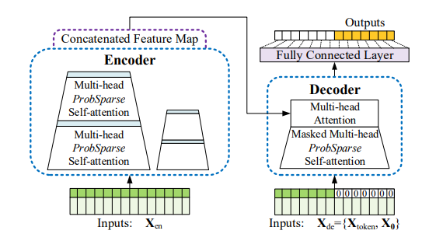
Informer model overview
① ProbSparse Attention
② Encoder
③ Decoder
Notes:
Informer model overview. Left: The encoder receives massive long sequence inputs (green series). We replace canonical self-attention with the proposed ProbSparse attention. The blue trapezoid is the self-attention distilling operation to extract dominating attention, reducing the network size sharply. The layer stacking replicas increase robustness. Right: The decoder receives long sequence inputs, pads the target elements into zero, measures the weighted attention composition of the feature map, and instantly predicts output elements (orange series) in a generative style.

Slide 9
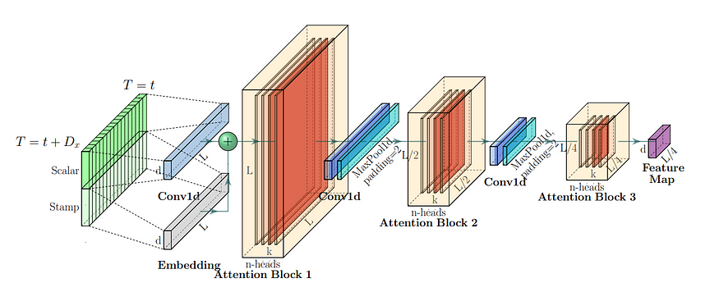
schematic architecture of the encoder
<schematic architecture of the encoder>
Notes:
< The single stack in Informer’s encoder. (1) The horizontal stack stands for an individual one of the encoder replicas
in Fig.(2). (2) The presented one is the main stack receiving the whole input sequence. Then the second stack takes half slices
of the input, and the subsequent stacks repeat. (3) The red layers are dot-product matrixes, and they get cascade decrease by
applying self-attention distilling on each layer. (4) Concatenate all stacks’ feature maps as the encoder’s output.

Slide 10
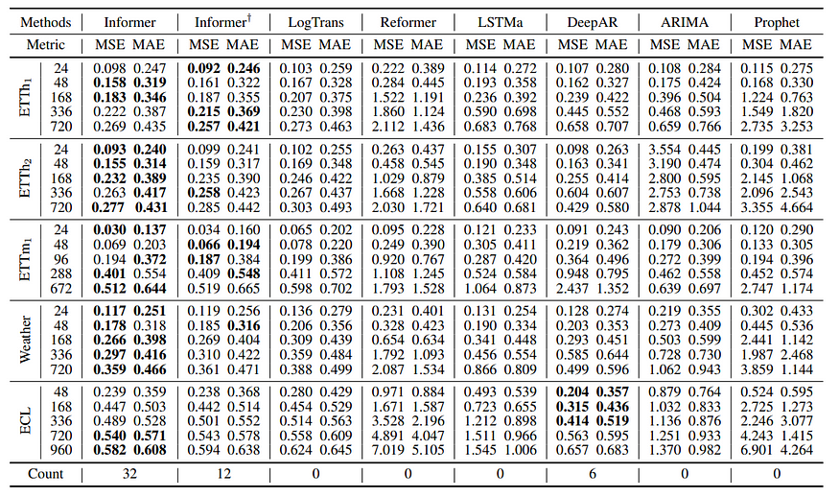
Experiment result
<Univariate long sequence time-series forecasting results on four datasets (five cases)>
-Informer† : 기존 Informer에서 ProbSparse self-attention을 canonical self-attention으로 대체한 모델, --LogTrans와 Reformer : Attention computation/memory complexity를 개선한 모델
Notes:
We used Comparison models include ARIMA , Prophet , LSTMa , LSTnet and DeepAR. To better explore the ProbSparse selfattention’s performance in our proposed Informer, we incorporate the canonical self-attention variant (Informer†), the efficient variant Reformer and the most related work LogSparse self-attention in the experiments.

Slide 11
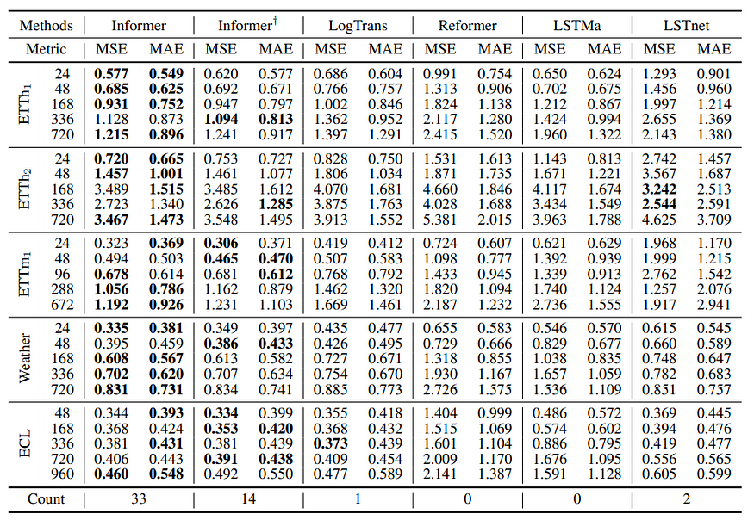
Experiment result
<Multivariate long sequence time-series forecasting results on four datasets (five cases)>
-Informer† : 기존 Informer에서 ProbSparse self-attention을 canonical self-attention으로 대체한 모델, --LogTrans와 Reformer : Attention computation/memory complexity를 개선한 모델
Notes:
Informer† : 기존 Informer에서 ProbSparse self-attention을 canonical self-attention으로 대체한 모델 • LogTrans와 Reformer : Attention computation/memory complexity를 개선한 모델

Slide 12
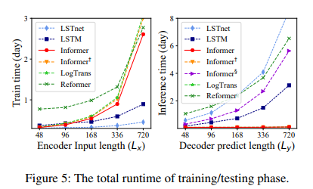
The total runtime of training/testing phase
<The total runtime of training/testing phase>
Notes:
Informer 모델이 transformer 기반 모델 중에서는 가장 좋은 training efficiency를 보이고 있으며 testing 시에도 훨씬 빠른 decoding 속도를 보이고 있음

Slide 13
Conclusion
Notes:
In this paper, we studied the long-sequence time-series forecasting problem and proposed Informer to predict long sequences. Specifically, we designed the ProbSparse selfattention mechanism and distilling operation to handle the challenges of quadratic time complexity and quadratic memory usage in vanilla Transformer. Also, the carefully designed generative decoder alleviates the limitation of traditional encoder-decoder architecture. The experiments on real-world data demonstrated the effectiveness of Informer for enhancing the prediction capacity in LSTF problem.

